Slide 1
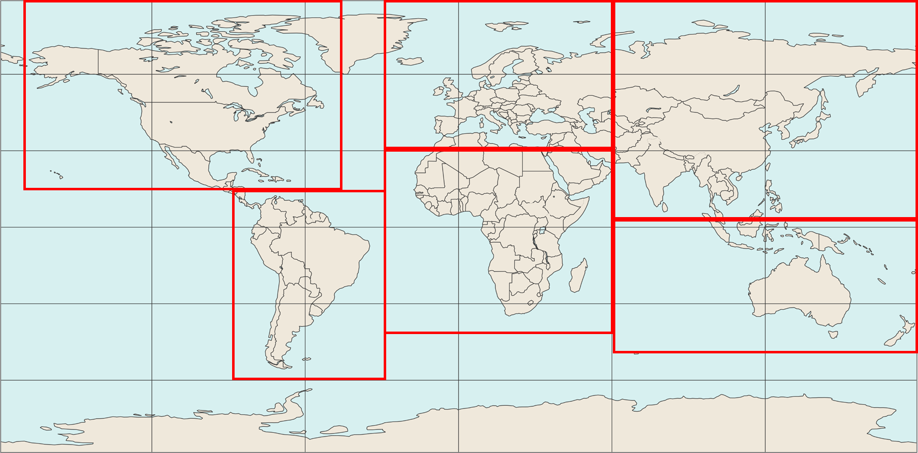
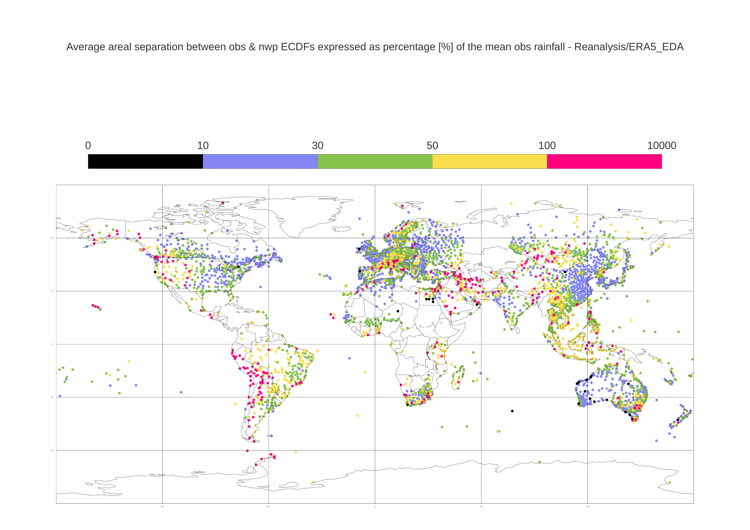
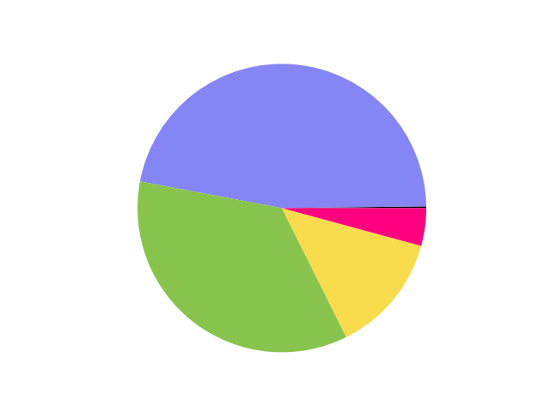
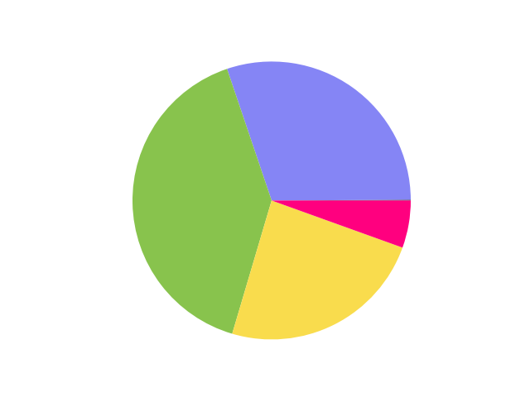
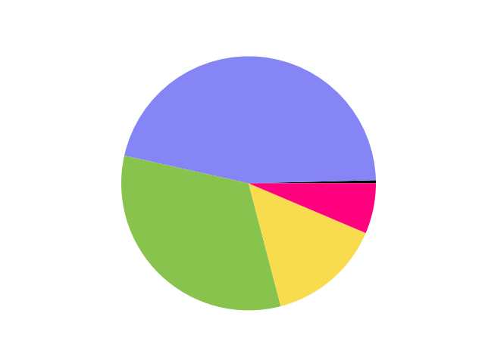

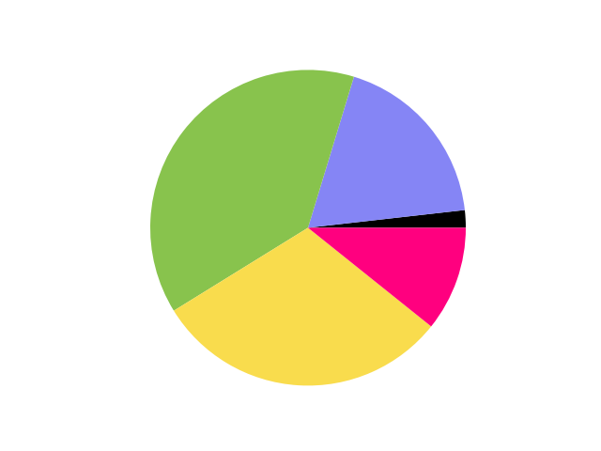
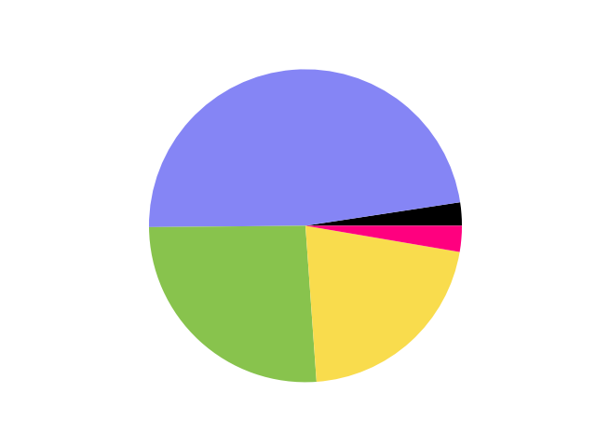
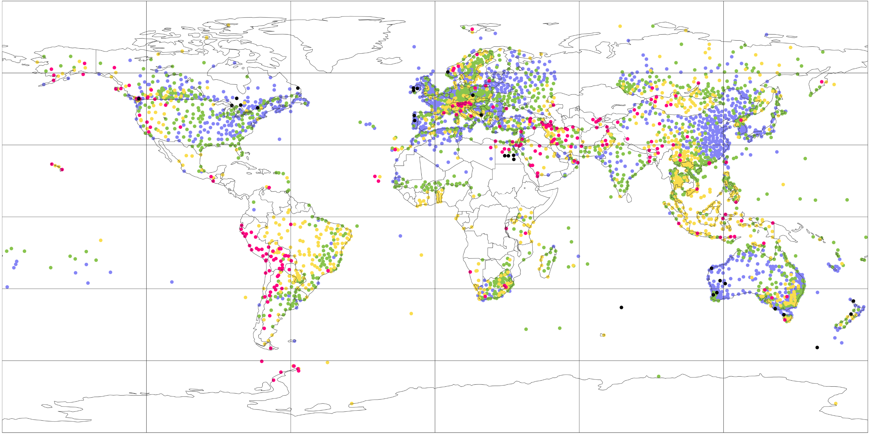
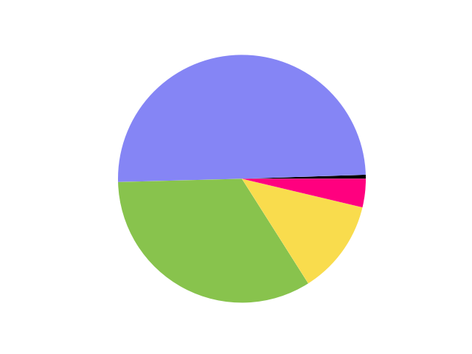
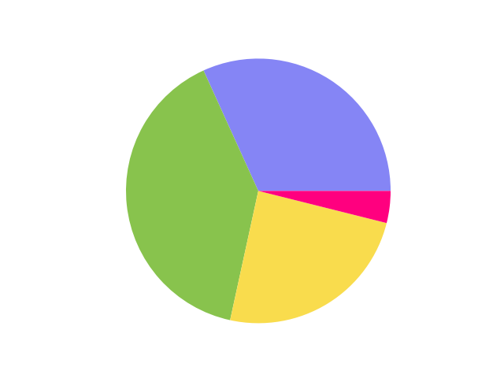
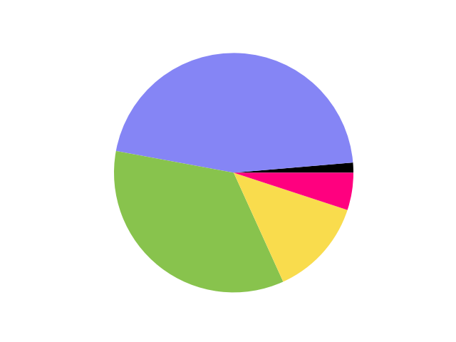

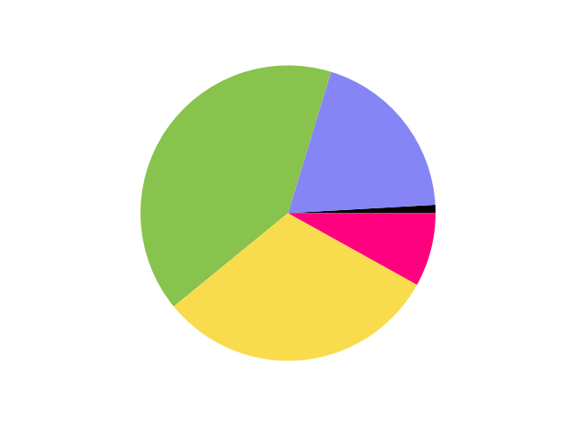
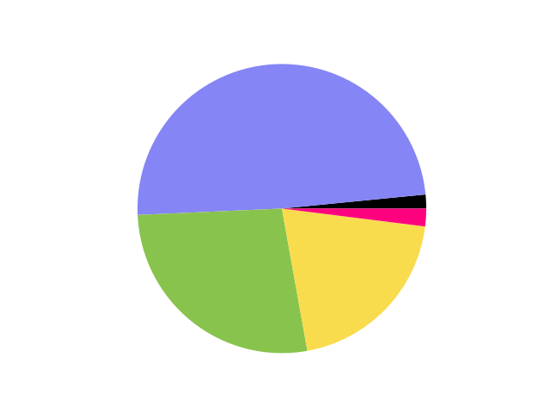
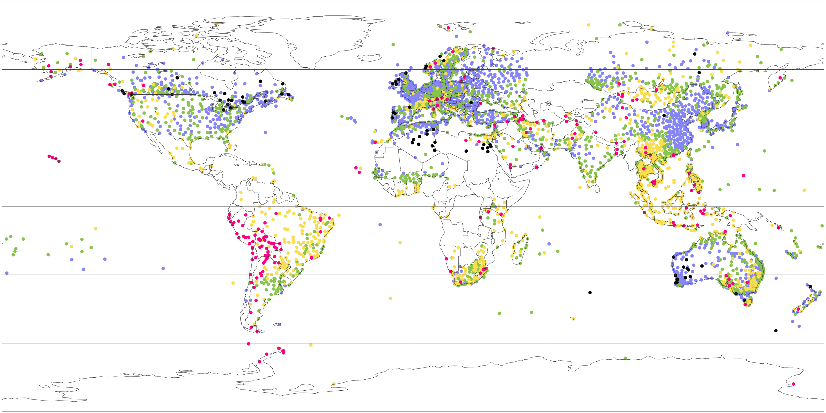
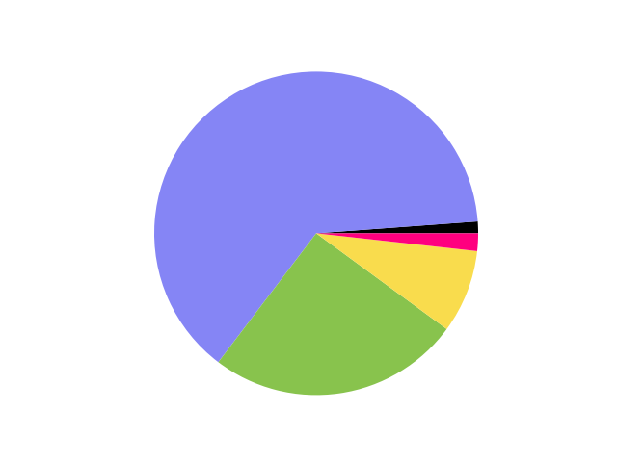
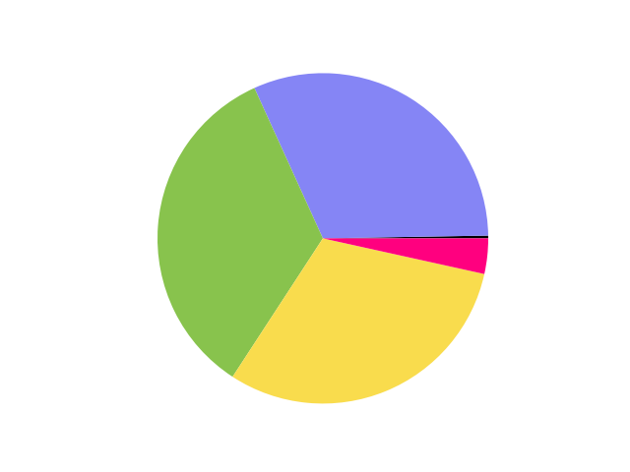
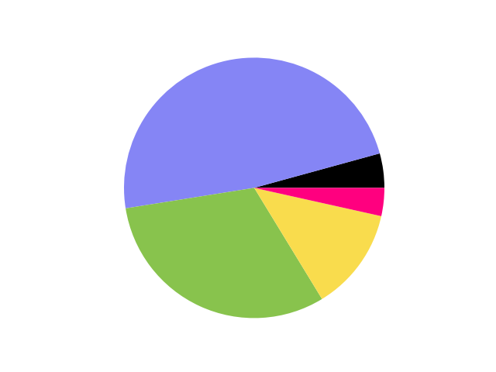
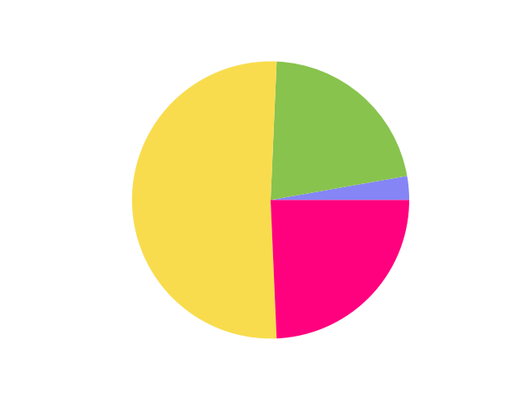
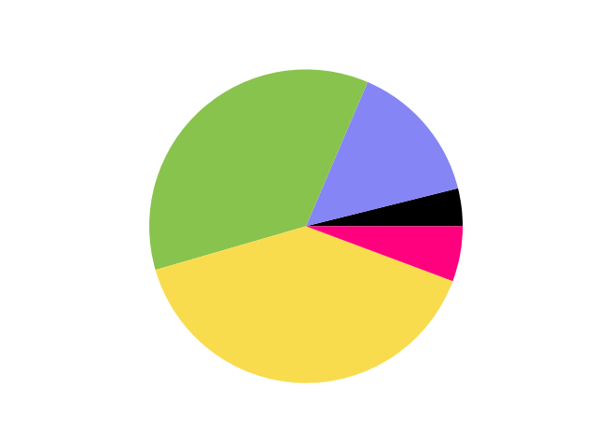
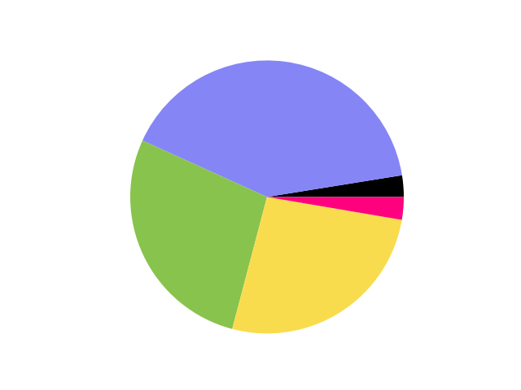
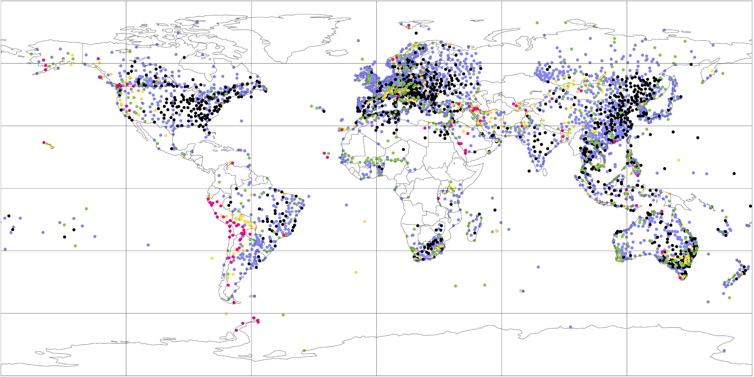
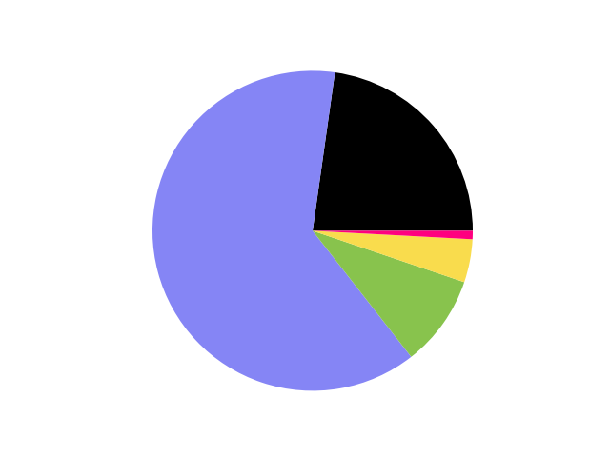
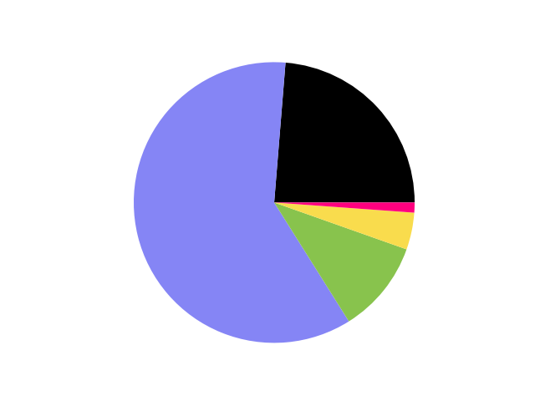
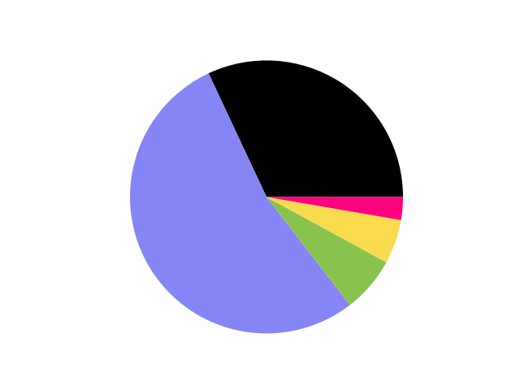
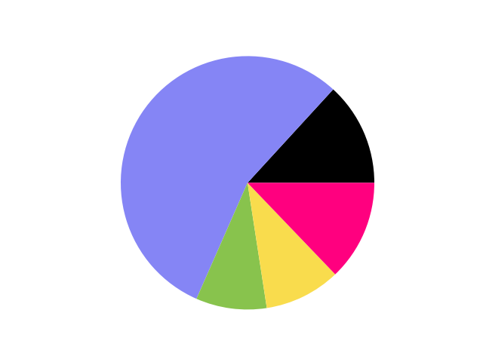
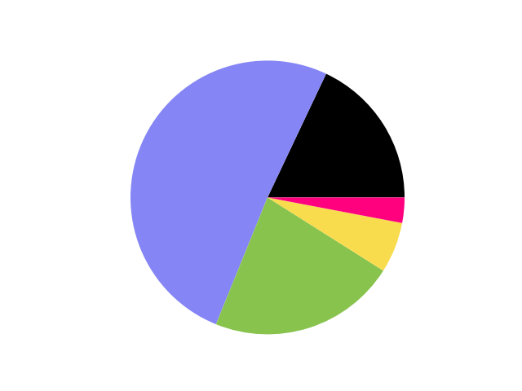
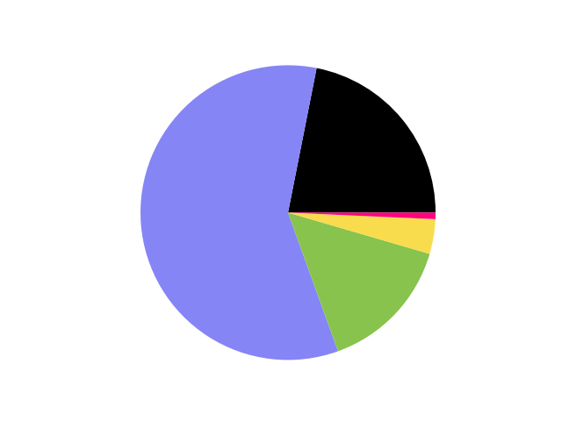
Normalized Mean Absolute Error (MAE_{NORM}) for 24-hourly total precipitation
MAE_{NORM} values at each rain gauge station (left column) and piecharts’ numerical values (right column)
120 °W
60 °W
0 °E
60 °E
120 °E
North America [90 °N, 170 °W, 15 °N, 50 °W]
60 °N
South America [15 °N, 100 °W, 60 °S, 30 °W]
(a) Domains to create the piecharts
30 °N
Europe & Mediterranean [90 °N, 30 °W, 30 °N, 60 °E]
0 °N
Africa & Arabian Peninsula [30 °N, 30 °W, 40 °S, 60 °E]
30 °S
Asia [90 °N, 60 °E, 5 °N, 180 °E]
60 °S
Oceania [5 °N, 60 °E, 60 °S, 180 °E]
0
0.1
0.3
0.5
1
100 [-]
(b) ERA5 - EDA (62 km)
60 °N
30 °N
70 °S
0 °N
30 °S
60 °S
(c) ERA5 (31 km)
60 °N
30 °N
0 °N
30 °S
60 °S
(d) ECMWF Reforecasts - 46r1 (18 km)
60 °N
30 °N
0 °N
30 °S
60 °S
(e) ERA5 – ecPoint (point-scale in 31 km grid)
60 °N
30 °N
0 °N
30 °S
60 °S
120 °W
60 °W
0 °E
60 °E
120 °E

